Slide 1



Department of Computer Science and Engineering
EXAM APP FOR VISUAL IMPAIRED PERSON
UDAYAKUMAR.G(211420104341) PRASANNA KUMAR U. (211420104331) N DHANUSH VARTHAN R.V(211420104322)
Guide Name & Designation
Dr. Vinmathi M.S
Coordinator Name & Designation
Dr. Pughazendi.N

Slide 2
Abstract
The inclusive education application revolutionizes learning for visually impaired individuals by providing a user-friendly interface powered by advanced voice recognition technology. Addressing the accessibility gap in traditional educational systems, the application allows users to effortlessly navigate educational participate in assessments using spoken commands and auditory feedback. By leveraging cloud computing, the application ensures scalability, reliability, and collaborative capabilities, facilitating a seamless learning experience across different devices. The integration of voice recognition technology empowers visually impaired users to independently access a wide range of educational resources, promoting inclusivity and equality in education. Through intuitive navigation and real-time interaction features, the application fosters a supportive learning community, enabling users to engage with content and collaborate with peers effectively. Overall, the inclusive education application represents a transformative innovation in educational technology, breaking down barriers and empowering visually impaired individuals to pursue their academic goals with confidence and independence.

Slide 3
Introduction
The growth of the Internet, and in particular the Web, is already influence the way science is taught and will undoubtedly do so to greater extent in the future. In areas of education, it offers a medium that has the potential to be more responsive to students. Web based Examination system could be used via Internet or intranet for managing student examination
In the future blind peoples also can do online exam like a normal human if Test can be taken using an Android Application, Here Questions & choice are through in Voice our project is delivered in real time and Tests can be taken anytime
Blinds can login the exam using their Application. The Answer will be getting from the user through voice. The results also delivered through voice. The marks are automatically collected, analyzed, and distributed for purposes like evaluation of teaching and learning process. In this world blind peoples can get the knowledge using various interfaces. Such as one common method of the blind people has been intended to use is by voice recognition.

Slide 4
Objective of the Project
A number of developing countries continue to provide educational services to students with disabilities in “segregated” schools. Also, all students, regardless of their personal circumstances, have a right of access to and participation in the education system, according to their potential and ability.
However, with the rapidly growing population and increasing number of people with blindness along with other disabilities, need for use of technology in the field of education has become imminent.
With existing system of competitive examination, students face problems while interacting with the system, misunderstandings arising due to human mediator and also an ability to cope-up with the other students.
Our project, through the use of speech technology, attempts to provide solutions for some of these issues by creating an interactive system.
Thus, the application will help in creating an environment that provides equal opportunities for all the students in taking up competitive exams. This will improve the current educational system for blinds career.

Slide 5
Literature Survey
YEAR | TITLE/Jurnal | AUTHOR | DESCRIPTION | ADVANTAGE | DISADVANTAGE
2020 | Assistive technology for students with visual impairments | Mulloy, Austin M., Cindy Gevarter, Megan Hopkins, Kevin S. Sutherland, and Sathiyaprakash T. Ramdoss | Distance education portal using PHP, MySQL, JAWS, HTML5, and CSS3 for blind people to access education packages and course information | Provides access to education for the blind | Requires knowledge of screen reading tools and web development
2016 | In 2016 IEEE International Conference on Computational Intelligence and Computing Research (ICCIC), pp. 1-4. IEEE | Kumar, M. Naveen, PC Linga Chandar, A. Venkatesh Prasad, and K. Sumangali. | Suggested voice-enabled systems for communication and knowledge acquisition as only 2% of the blind community can use Braille | Allows communication and access to information without Braille knowledge | May be expensive to implement and may require technological support

Slide 6
Literature Survey
YEAR | TITLE/Jurnal | AUTHOR | DESCRIPTION | ADVANTAGE | DISADVANTAGE
2008 | "Learning platform for visually impaired children through artificial intelligence and computer vision | In 2017 11th International Conference on Software, Knowledge, Information Management and Applications (SKIMA), | Developed an application using Artificial intelligence, computer vision, Deep Region Convolutional Networks, Recurrent Neural Networks, and speech models to help blind children between the ages of 6 to 14 years identify objects | Provides a technological solution for object identification | May be limited in scope and accessibility
2016 | Yurtay, Nilufer, Yuksel Yurtay, and M. Fatih Adak | An education portal for visually impaired. | Developed an android application with a chatbot for blind people to obtain education-related information using Google voice search | Provides access to education-related information | Requires knowledge of voice search and may not be suitable for all types of education-related queries

Slide 7
Existing
The blind people who want to take the examination require a writer pad.
The writer pad writes the answers which the blind dictates them. The traditional way for conducting examination for the blind people requires scribe/writer.
These candidates face difficulties in using the scribes for examinations. It is hard for them to dictate the answers to the scribes. Because, the scribes might be of lower qualification hence they cannot interpret their words and write them down as they are.
The examination system for blinds allows volunteers to write exams on behalf of blind candidates. Finding a responsible person to do the writing for them in the examination hall is no less a source of tension for blind students than the problems created by their disability. Lack of writers is particular tender for blind students studying for advanced degrees in universities.

Slide 8
Problem Statement
Time delay.
less accurate in voice .
Manual process needs to be monitored.
Blind students cannot access independently, rely on others

Slide 9
Proposed System
This project proposes a system that will create a revolution in a world of education by providing an easier way for visually impaired people to take tests just as normal students do.
Rapidly growing population and increasing number of people with blindness along with other disabilities need for use of technology in the field of education has become imminent. With existing system of competitive examination, students face problems while interacting with the system, misunderstandings arising due to human mediator and also an ability to cope-up with the other students.
Our project, Android App through the use of speech technology, attempts to provide solutions for some of these issues by creating an interactive system.
Thus, the application will help in creating an environment that provides equal opportunities for all the students in taking up competitive exams. This will improve the current educational system for blinds career.

Slide 10
Software / Hardware used
Android studio
Python Anywher(SQL)
JAVA
Desktop / Laptop
1GB RAM
Android Phone

Slide 11
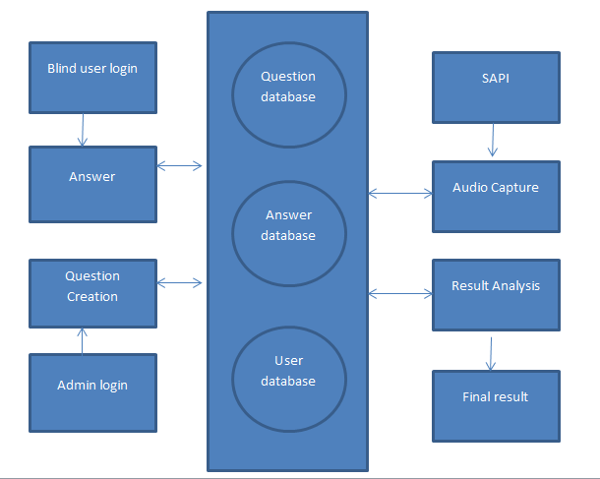
Architecture / Methodology used

Slide 12
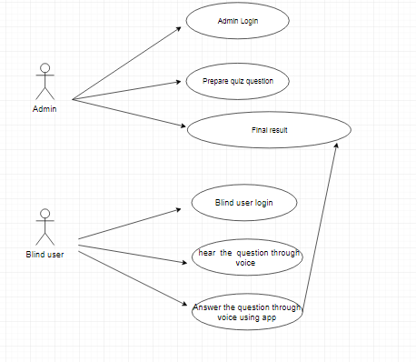
USE CSE DIGRAM
Use case Diagram

Slide 13
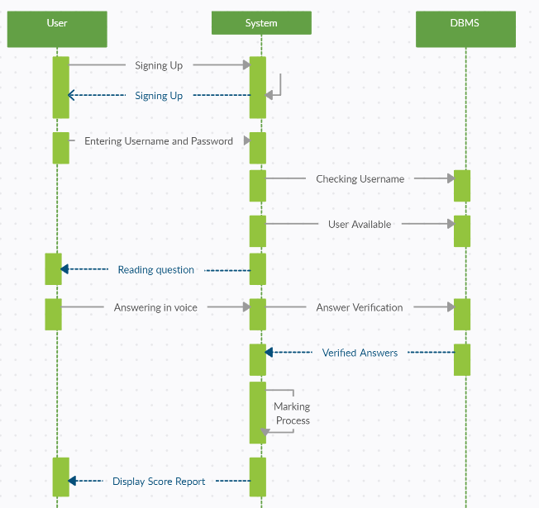
SEQUNCE DIGRAM

Slide 14
Module Description
Set MCQ Question Module: This module serves as a foundational component within the online testing platform, allowing administrators or content creators to populate the database with multiple-choice questions (MCQs). Through a user-friendly interface, individuals can input question text, define answer choices, designate correct responses, and include relevant metadata. Integration with authentication systems ensures secure access and modification rights. By centralizing MCQ management, this module streamlines the process of curating test content, promoting efficiency and consistency in question creation.
Take MCQ Test Module: Users access this module to engage in multiple-choice assessments within the online testing platform. Upon selecting a test, individuals navigate through a series of MCQs, providing answers and receiving immediate feedback on their performance. The module's intuitive interface facilitates seamless interaction, enabling users to focus on test content without distractions. Integration with the database ensures that test questions are dynamically retrieved, allowing for personalized and adaptive assessments tailored to each user's proficiency level.

Slide 15
Module Description
Set Paragraph Question Module: Designed to accommodate assessments requiring longer, written responses, the Paragraph Question module empowers administrators to craft prompts that elicit critical thinking and analysis from test-takers. Within this module, users input question prompts, specify response formats, and provide any necessary instructions. Integration with other platform modules enhances versatility, enabling seamless linkage between paragraph questions and related topics or MCQs. By supporting varied assessment formats, this module fosters deeper comprehension and expression among users.
Take Paragraph Question Test Module: Test-takers utilize this module to engage in assessments featuring paragraph-based questions, showcasing their ability to articulate ideas and insights effectively. Upon accessing a test, users read prompts, compose written responses, and submit their answers for evaluation. Integration with the platform's database ensures secure storage of user submissions, facilitating efficient grading and feedback delivery. Through this module, users demonstrate their comprehension and communication skills, contributing to a holistic assessment experience within the online testing platform.

Slide 16
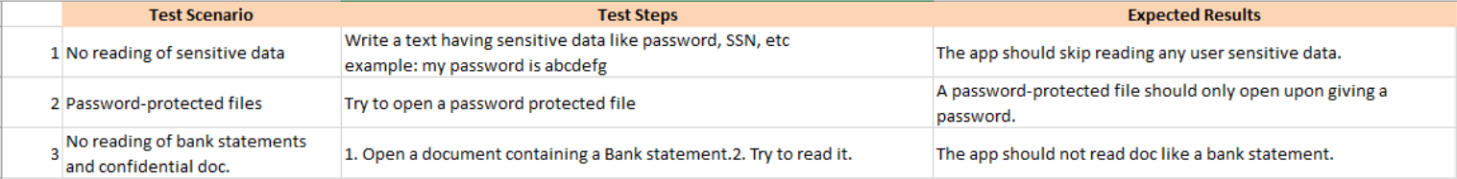
Testing
The purpose of testing is to discover errors. Testing is the process of trying to discover every conceivable fault or weakness in a work product.
It provides a way to check the functionality of components, sub-assemblies, assemblies and/or a finished product It is the process of exercising software with the intent of ensuring that the Software system meets its requirements and user expectations and does not fail in an unacceptable manner.
There are various types of test. Each test type addresses a specific testing requirement

Slide 17
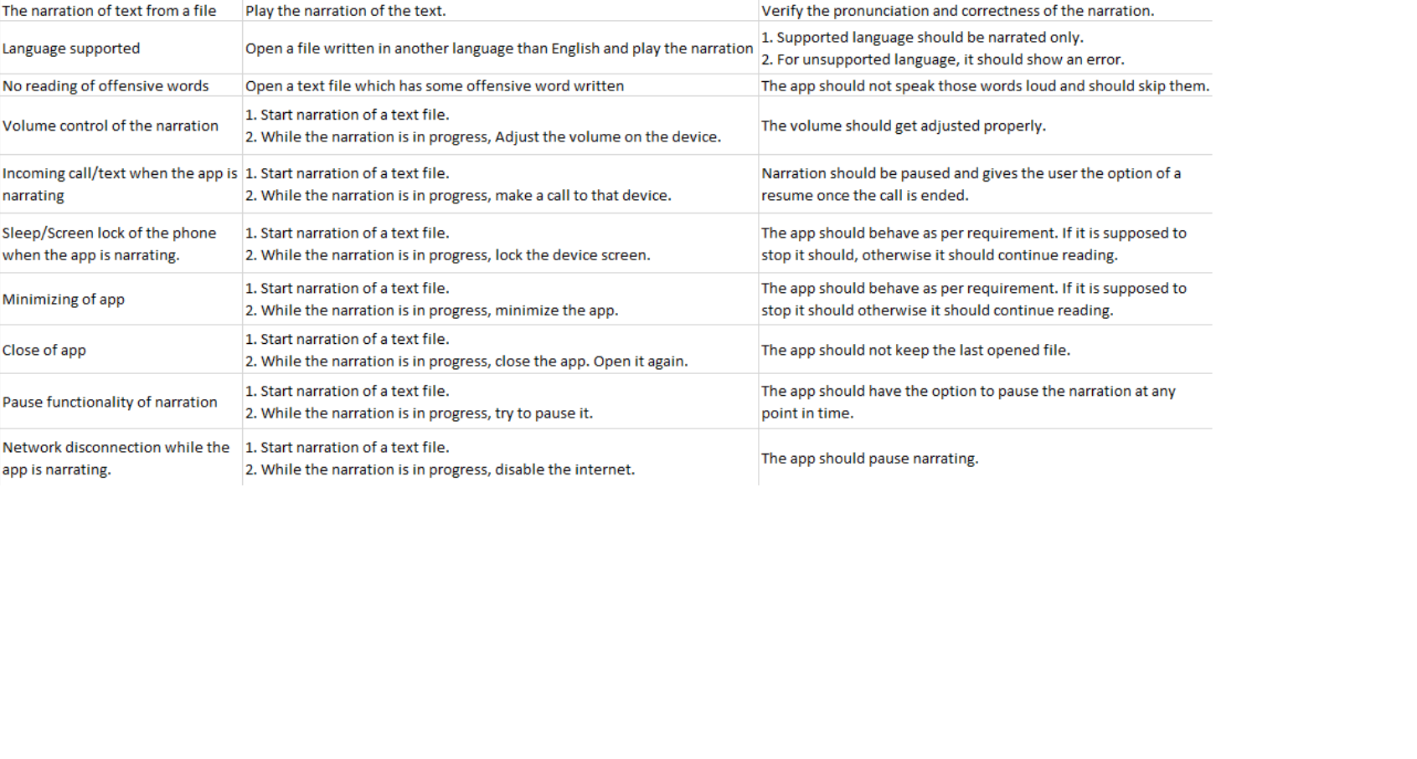
Testing

Slide 18
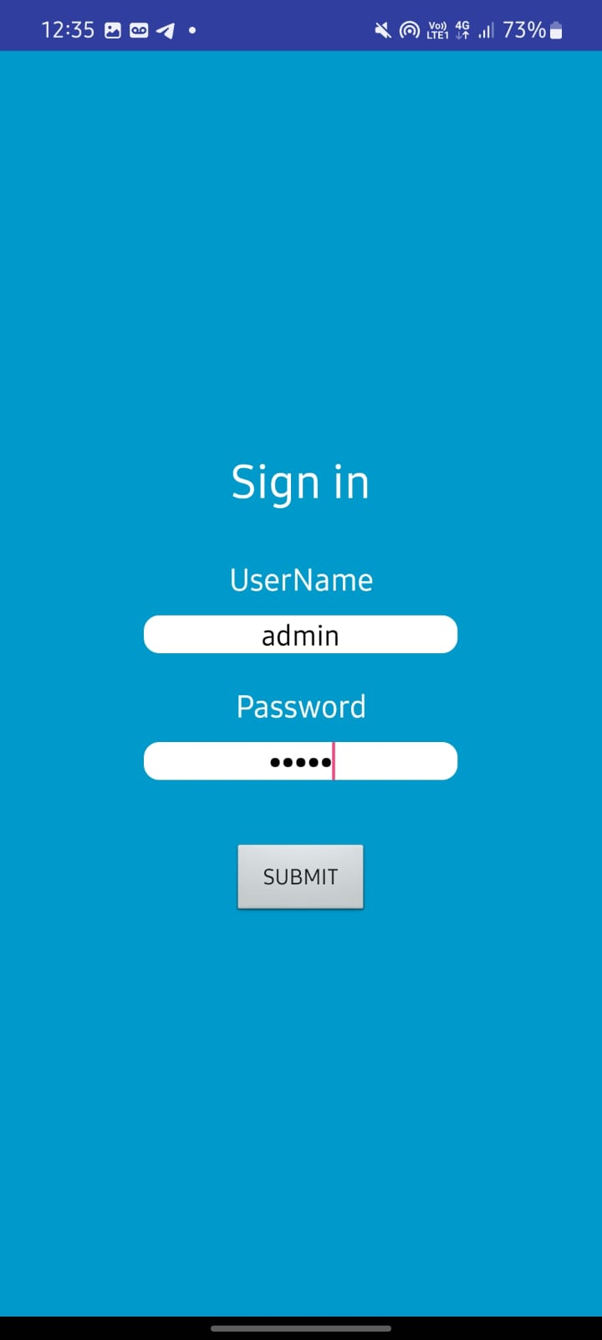
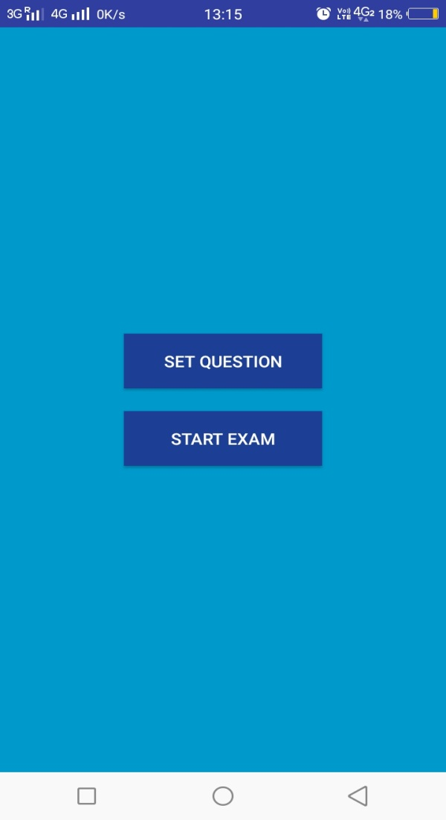
Screen Shots

Slide 19
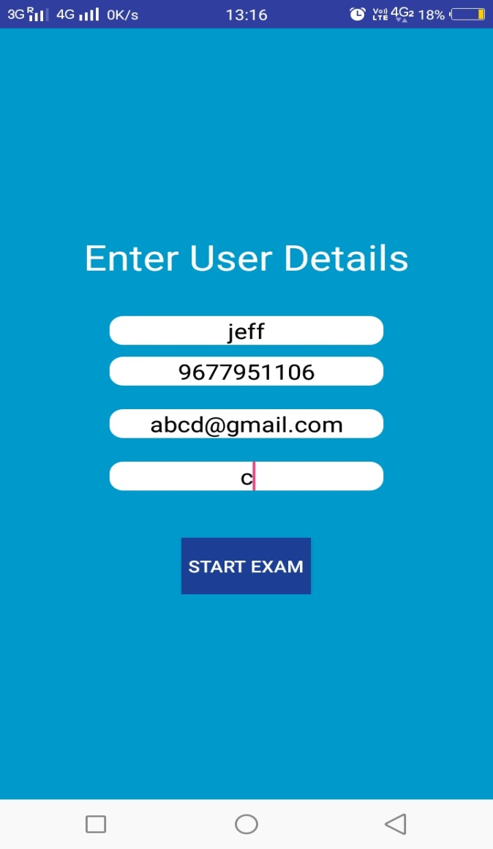
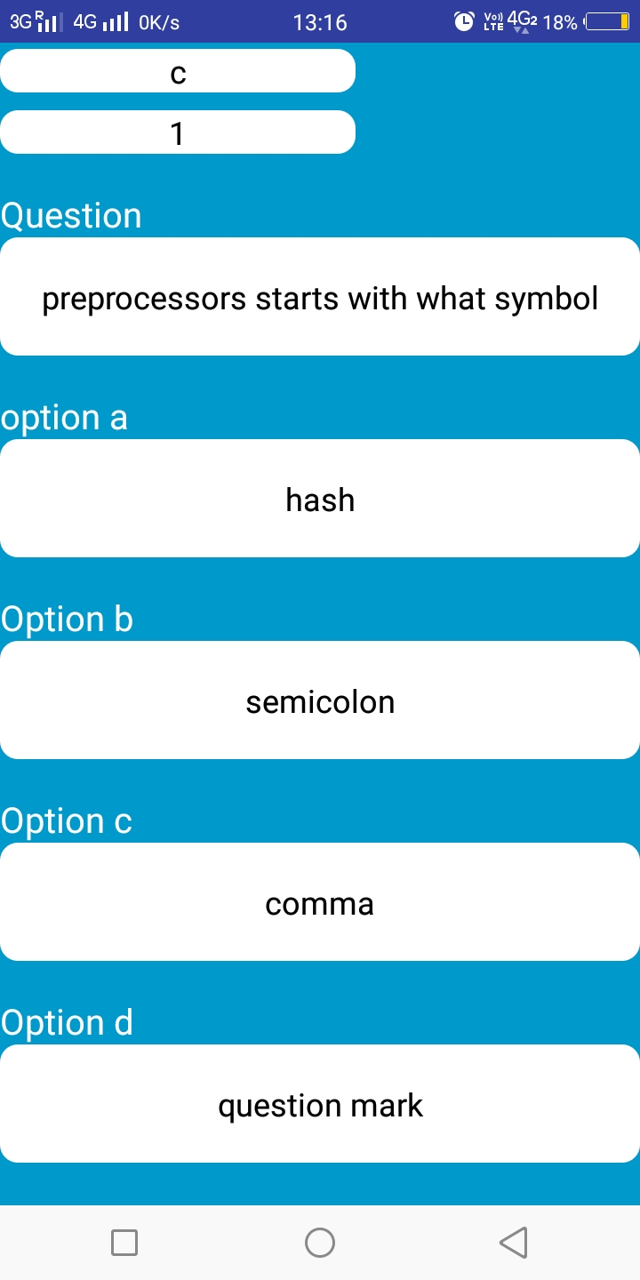
Screen Shots

Slide 20
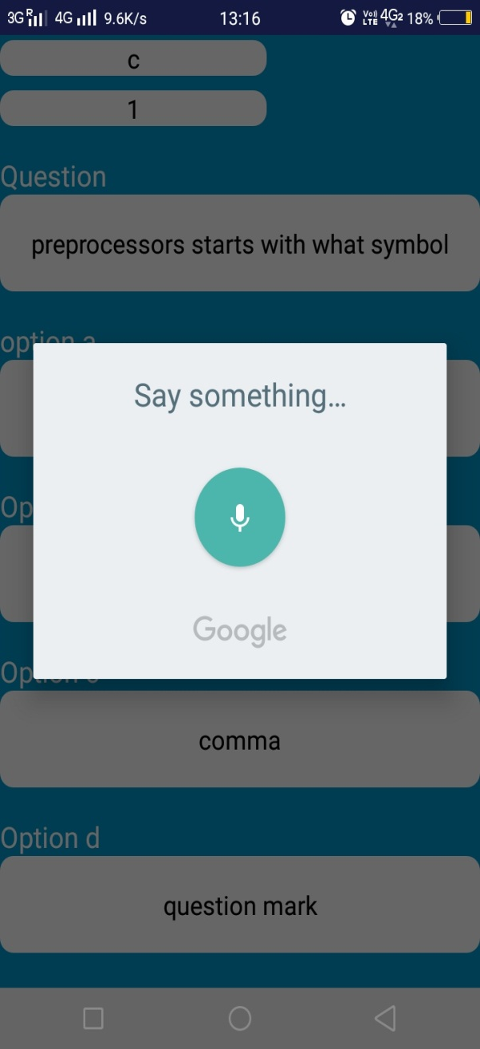
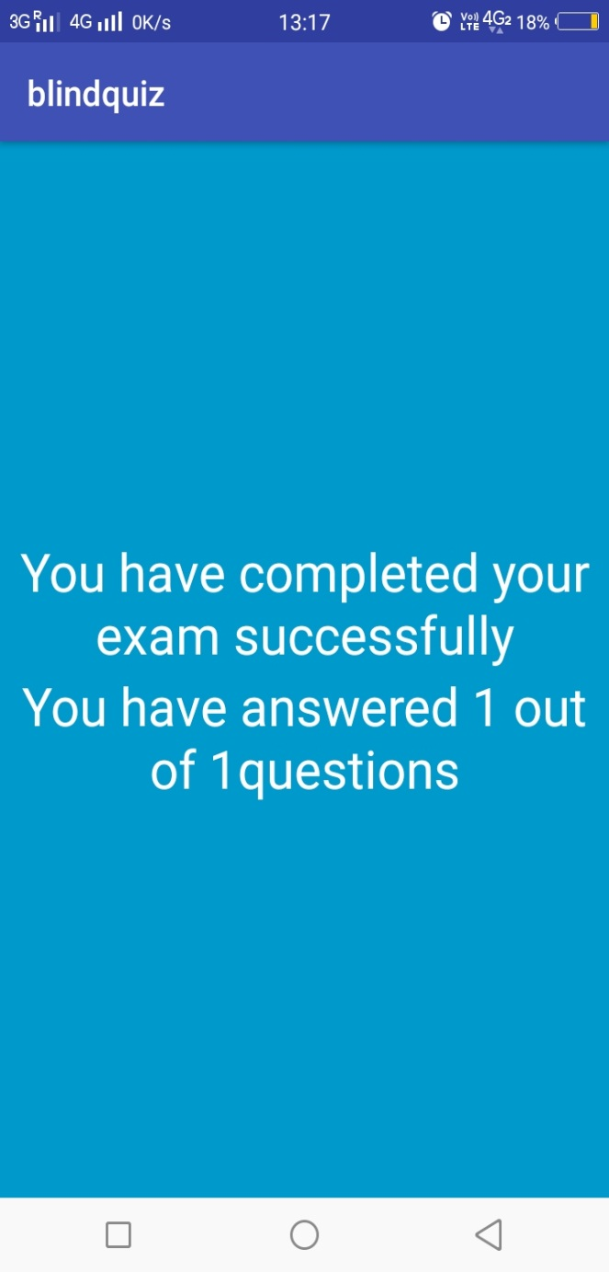
Screen Shots

Slide 21
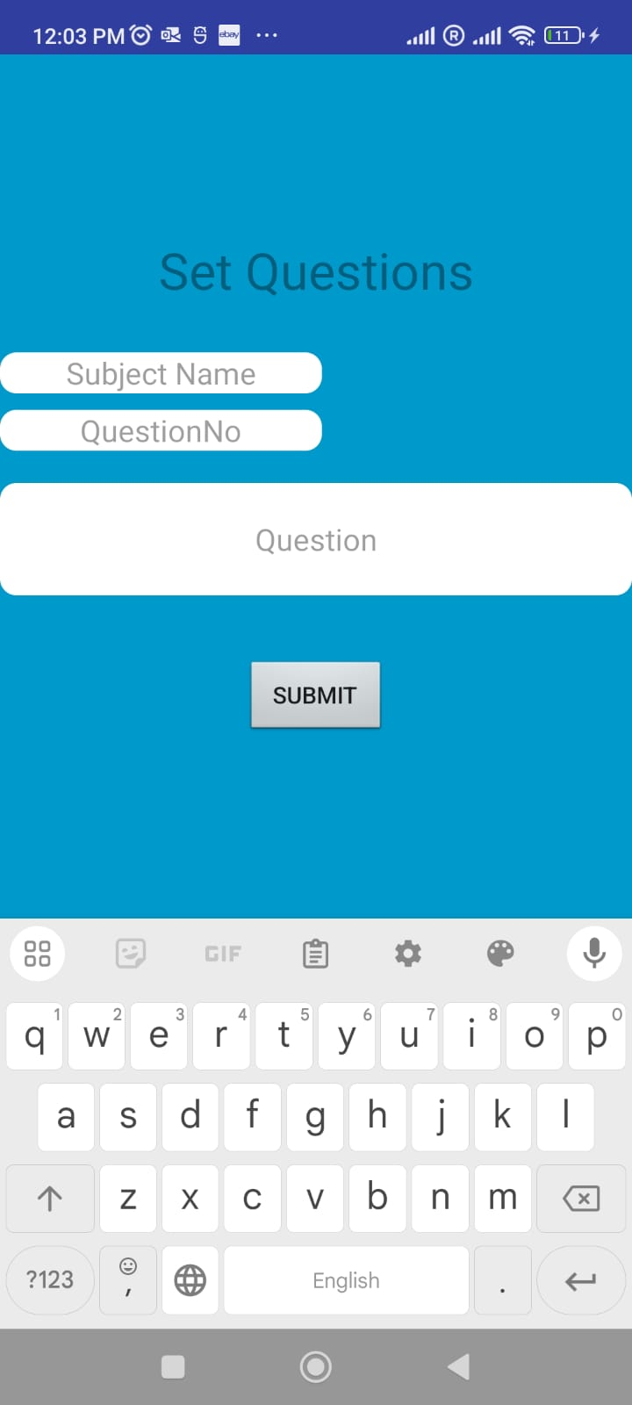
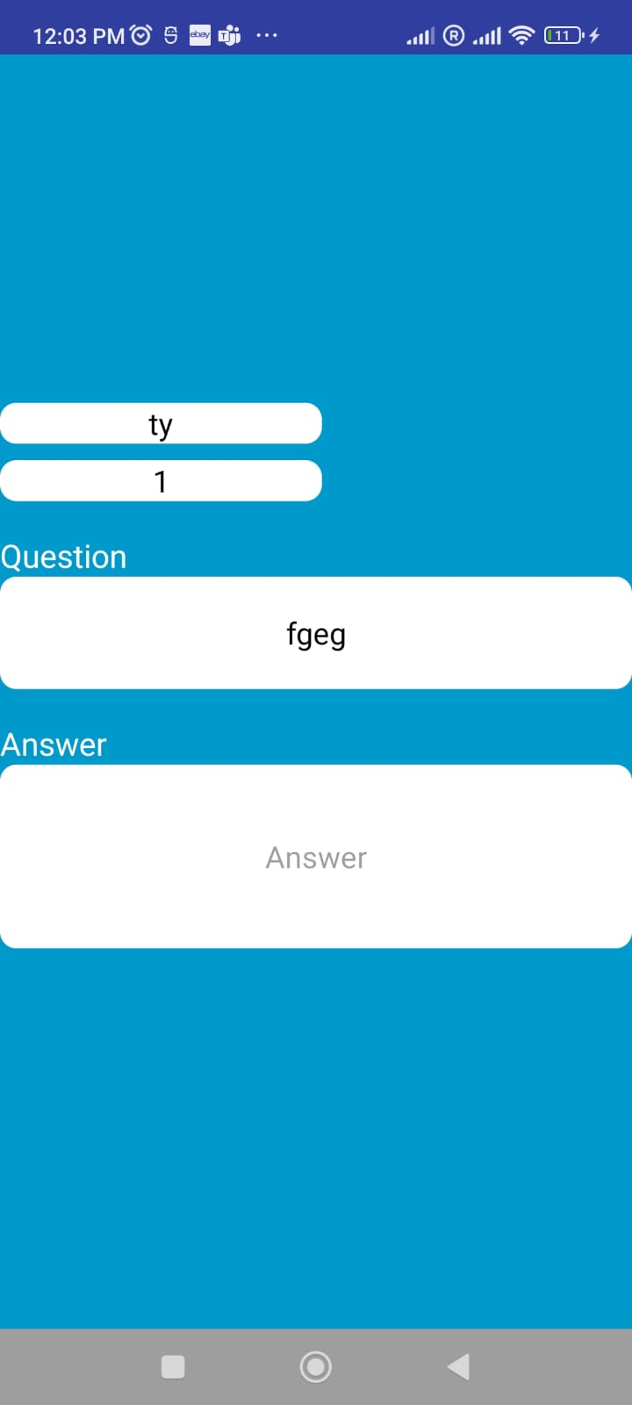
Screen Shots

Slide 22
Conclusion
This project would be a very useful one for every blind people and physically challenged to admire their talent easily through Quiz app like other humans.
In our project we will be going to deliver an entire application for physically challenged people which can provide an interactive interface.
Examinee can easily give exam by giving easy voice commands. Thus, physically challenged people can easily give exam like a common man without much difficulty.
Through this they have been able to attend many exams in the future and also, we will try to do as much as improvement in future as per the collection of feedback.

Slide 23
Reference Paper/ URL
https://ieeexplore.ieee.org/document/9670936
https://ieeexplore.ieee.org/document/9074847

